Slide 1
A BRIEF GUIDE PURCHASING YOUR FIRST HOME
2507 Post Road, Southport, CT 06890, (203) 254-7579
5 Brook Street, 2B, Darien, CT 06820, (203) 309-5500
www.russoassoc.com | E-mail - rob@russoassoc.com

Slide 2
BUYING A HOME…
Finally deciding which home is right for you is only the first step!

Slide 3
In order to purchase it, you must:
1.
2.
3.
4.
5.
6.
Make an offer
Negotiate price, credits and repairs with the seller
Sign a contract
Obtain a Mortgage
Obtain and ensure clear title
Close!
This presentation will try to simplify the process and ease your concerns.

Slide 4
1. Make an Offer
First, Figure out what you can afford. It’s important to contact a mortgage broker first to see what size loan you qualify for. You may be surprised (for better or worse). Some sellers will ask to see a “pre-approval letter” before they will take you seriously.
When you find the home that is right for you, the first step is to make an offer.
If you are using a realtor, the realtor will present the offer to the seller on a document called a Real Estate Binder.

Slide 5
This is a very basic document that lists:
The Buyer and Seller’s contact information
The property being sold
The purchase price
The size of the buyer’s mortgage
Important contract information Which items will remain at the property and which items the Seller will be taking with them
It usually requires a “good-faith” deposit
of 1% at the time of signing. You will put down
An additional; 9% when you sign the contract.
(The binder isn’t legally “binding”. It’s a summary
of the basic terms of the deal that the lawyers
will use to draft the legally binding contract.)

Slide 6
2. Negotiate Price, Repairs and Credits with the Seller

Slide 7
Negotiate Price, Repairs and Credits with the Seller
After your binder offer is accepted you will conduct an inspection of the property (before the contract is signed). This is important as it is your chance before committing to buy to see just what the condition of the house is.
Frequently, there will be certain issues with the home that will need to be addressed.
For instance, i.e. roof damage, broken windows, radon remediation, etc.
Sometimes these issues are resolved by the Seller agreeing to repair them; other times, they Seller agrees to give the Buyer a credit towards the purchase price so the Buyer may fix them.
Occasionally, a seller will refuse any such accommodation, insisting the home be sold “as is”.

Slide 8
Negotiate Price, Repairs and Credits with the Seller
If the buyer has an FHA loan (a loan insured by the federal government), any such repairs must be resolved prior to closing.
These outstanding issues are memorialized in a “Rider,” which is attached to the end of a contract.
It can also be necessary to attach riders to contracts governing unique issues like condominiums or short sales (where the mortgage owed on a property is for more than the sales price).

Slide 9
3. Sign a Contract

Slide 10
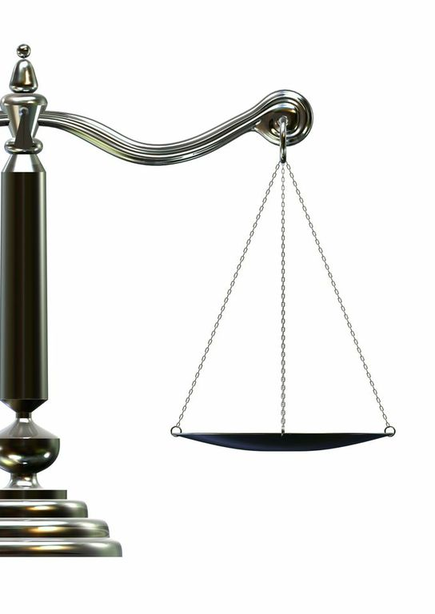
Sign a Contract
The contract is the legal document that governs parties in a real estate transaction.
Usually you will be expected to make an additional deposit of 9% upon signing (in addition to binder deposit).
It formalizes the terms of the binder and sets forth what is expected of both parties in order to close.
This is a more detailed document that contains additional information, including:
Mortgage Contingency Date (The date by which you - the buyer - can back out if you cannot get a commitment from your mortgage company to loan you money for purchase of the home)
A more detailed list of items included and excluded from the sale of the property.
Details regarding the condition the property is to be delivered in.
Descriptions of penalties for delay.
Language describing what actions constitute default by both parties.
The contract will be drafted by the Seller’s attorney and reviewed by the Buyer’s attorney

Slide 11
4. Obtain a Mortgage

Slide 12
Obtain a Mortgage
Once the contract has been signed, the Buyer and their attorney will focus on securing a loan from a mortgage company. Usually, this process will already have begun before the contract is signed.
The bank will make you pay for an appraisal of the property to confirm it is worth what you have agreed to pay for it.
Your bank will provide you with a Good Faith Estimate (“GFE”) of closing costs before you sign a mortgage commitment. Be sure to compare closing costs when shopping for a mortgage, not just rates.

Slide 13
Obtain a Mortgage
Obtaining a mortgage can sometimes be a frustrating process. You will have to gather together a good deal of paperwork under a time crunch before the closing. Expect to have to provide tax returns (at least 2 years), bank statements, pay stubs, and explanations for unique bonuses, deposits, and expenses.
Be cautious that just because a bank “pre-approves” you or provides you with a mortgage commitment does not mean you are guaranteed to get the loan. Most commitments when first issued have several contingencies, which can be significant. Your attorney should not release your contract’s mortgage contingency until he is absolutely sure you are locked in for your mortgage. Otherwise your 10% deposit is at risk!

Slide 14
Obtain a Mortgage
The Buyer will have to obtain homeowner’s insurance for their new home. If the new home is in a flood zone, they will also have to obtain flood insurance.
A homeowner’s insurance policy also protects the bank. The Buyer will have to work with their attorney and insurance agent to ensure the correct language is include in the binder.

Slide 15
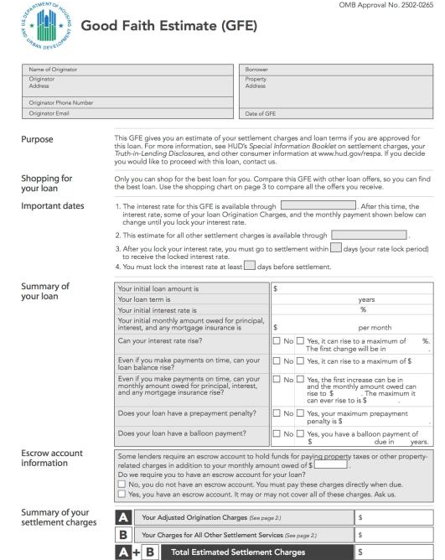
Sample GFE
Bank’s Information
Borrower’s Information
Date GFE issued by Bank
Interest rate locked until this date
Closing should be within this number of days
Amount of Loan
Interest Rate
Monthly Payment for Principal and Interest
Information on Structure of the Loan
Monthly Payment for Escrows on Property Taxes and Insurance
Bank Fee for Creating Loan
Bank Fees Due at Closing
Total Bank Fees

Slide 16
5. Obtain and Ensure Clear Title

Slide 17
Obtain and Ensure Clear Title
Unlike with personal property, a deed is not enough to show you own real property. Instead, with real estate we look at the “chain of title” to see all possible claims or encumbrances on the title.
Your Attorney will order a title search of the property you are purchasing to make sure the Sellers have the ability to sell “good title” and that all mortgages or liens on the property are paid off by the sellers at or before closing.
Your bank will have strict policies regarding the condition of your potential purchase’s title.
Your bank will require you to purchase a “Mortgagee’s Title Insurance Policy” that ensures the chain of title on your property for the lifetime of your mortgage.

Slide 18
Obtain and Ensure Clear Title
Your attorney will highly recommend you also buy an “Owner’s Title Policy” to protect you from any title defects for the entire time you own the home. Usually, it only costs a few hundred dollars more if you are already purchasing Mortgagee’s insurance.
Title insurance will protect you in case the unexpected occurs such as a previous owner claims they were never properly compensated, a neighbor challenges a boundary or an old mortgage bank claims they were never paid off.
Your Attorney will be compensated by the Title Insurance Company for having sold you the policy.

Slide 19
Sample Mortgagee Policy (Page 1)
Loan amount
Effective on date of closing
Mortgage company information
Information from when the mortgage was recorded
Property Address

Slide 20
Sample Mortgagee Policy (Page 2)
Various endorsements for added protection to the mortgagee

Slide 21
6. Close!

Slide 22
Close!
In the weeks leading up to the closing, the Buyer’s attorney will work with the mortgage lender and the Seller’s attorney to prepare all the documents needed for the day of closing.
In the morning, the Buyer will likely meet their real estate agent at the home for a final inspection to ensure it is in its expected condition.

Slide 23
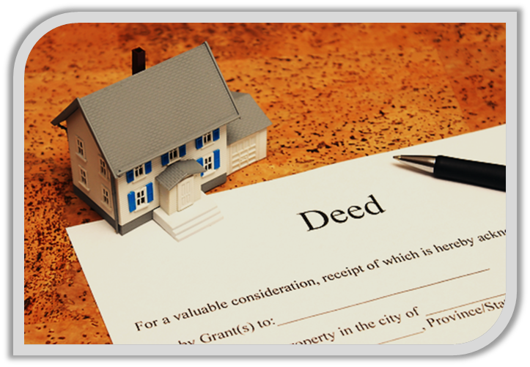
Close!
Then, the Buyer will meet their attorney and sign all the documents associated with their mortgage.
One document, known as the HUD, will contain detailed information on all amounts that are a part of the transaction.
The attorney will also provide a Closing Statement that explains the items in the transaction in a simple format.
Finally, the Buyer’s attorney will meet with the Seller’s attorney to exchange important documents and money for the purchase, which will have been already sent by the mortgage lender.
After the closing, the Buyer’s attorney will have to record the warranty deed and mortgage on the town land records.

Slide 24
Sample HUD (Page 1)
Date of Closing
Purchase Price
Items owed to Seller because they paid for it before closing
Contract Deposit
Amount for Seller to pay off their existing mortgage
Loan Amount
Items the Seller owes the Buyer because it was not paid before the closing
Amount Buyer must bring to closing
Amount Seller will directly receive at closing

Slide 25
Sample HUD (Page 2)
Real estate commissions paid by Seller
Charges from mortgage company
Interest owed from Buyer from closing date until end of the month
Annual premium for homeowner’s insurance
Total amount to be deposited in Buyer’s escrow account
Homeowner’s insurance and property tax escrow
Adjustment credit to Buyer
Total title insurance fee for owner and mortgagee’s policy
Fee to Buyer’s attorney
Fee for title search of property
Taxes owed by Seller for property transfer
Fee to record deed and mortgage on town land records
Total charges to Buyer at closing
Payment of recent tax installment
Total charges to Seller at closing

Slide 26
Sample Closing Statement
Purchase price
minus
Deposits made
equals
Amount still owed
minus
Credits to Buyer
plus
Credits to Seller
equals
To Seller at Closing
Loan amount
minus
Bank charges
equals
Amount received from bank
plus
Funds from Buyer at closing
equals
Total funds needed for closing
Checks owed to Seller
These amounts must equal
plus
Checks disbursed at closing
equals
Total Disbursed

Slide 27
Close!
Even though your purchase will have closed on the closing date, your attorney cannot close out your file until he is sure that releases for any mortgages or liens the seller may have had are properly recorded on the land records. This process may take months.
It is important for a Buyer to understand that there are almost always bumps in the road when buying a home. BUT, almost all of them can be worked through by the parties and their attorneys. Where might a Buyer expect to run into some issues?

Slide 28
Close!
No house is perfect. When there is a problem with the home, the Buyer expects the Seller to fix it and the Seller does not want to have to fix every issue with the home. However, their attorneys should have the experience to come to a mutually acceptable solution.
Buyers are busy with their daily lives and purchasing a home adds an extra burden. Most people simply do not have the time to do all that is needed for the closing at a moment’s notice. Gathering personal financial documents can be especially time-consuming. While the timeline for a typical closing usually allows the Buyer enough time to gather this information, the process can be slowed down if some of these documents prove hard to obtain.

Slide 29
Close!
Mortgage companies are issuing thousands of loans every day. While the weeks leading up to the closing may be quiet, the day before and on the closing may seem chaotic as the attorney waits for the documents and closing information from the mortgage company.
It is the attorney’s responsibility to stay on top of the mortgage company and ensure everything is set, but be prepared for a very active final hours before closing.

Slide 30
The End
Buying a home may be the biggest purchase of one’s life. While the process may seem intimidating, your attorney has the experience and expertise to lead you through the process.
In the end, you can be comforted that all the proper paperwork has been done, so you can begin your new life in your new home!

